Slide 1
mathematical optimization
CO2- Newton's Method

Slide 2





AIM OF THE SESSION
To familiarize students with the concept of Constrained optimization.
INSTRUCTIONAL OBJECTIVES
This Session is designed to:
Introduction to Newton's method
Working with Newton's method
Examples on Newton's method
LEARNING OUTCOMES
At the end of this session, the students should be able to:
Understand Newton's method

Slide 3
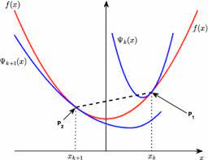
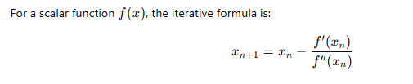
Newton's Method
Newton's Method for Curve Optimization is a second-order optimization technique used to find the local minima or maxima of a function. It uses both the first and second derivatives (gradient and Hessian in multivariable cases) to iteratively update the solution.

Slide 4
Newton's Method
Algorithm:
1. Initialization: Choose initial values for the model's parameters.
2. Iteration: Repeat until convergence:
o Calculate the gradient and Hessian: Compute the gradient (first derivative) and
the Hessian (second derivative) of the loss function with respect to the parameters.
o Update parameters: Update the parameters using the formula: xᵢ₊₁ = xᵢ - H⁻¹(xᵢ) * ∇f(xᵢ),
where H⁻¹ is the inverse of the Hessian matrix, and ∇f is the gradient.

Slide 5
Newton's Method
Example:1
Using the same function, f(x) = x² - 4x + 5, for Newton's method:
Initialization: Start with an initial guess, x₀ = 0.
Iteration:
  Gradient and Hessian:
    Gradient: f'(x) = 2x - 4
    Hessian: f''(x) = 2
  Update:
    x₁ = x₀ - f''(x₀)⁻¹ * f'(x₀) = 0 - 2⁻¹ * (-4) = 2
    x₂ = 2 - 2⁻¹ * (2*2 - 4) = 2
    In this simple case, Newton's method converges very quickly to the minimum (x=2). In more complex, multi-variable cases, it might take more iterations, and the calculation of the inverse Hessian matrix can be computationally expensive.

Slide 6
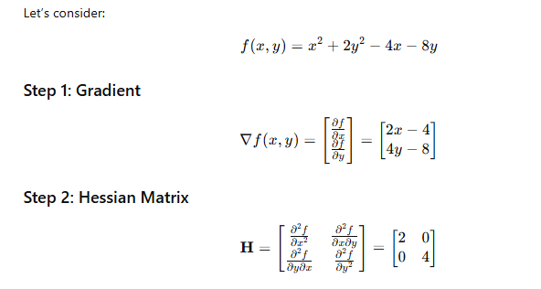
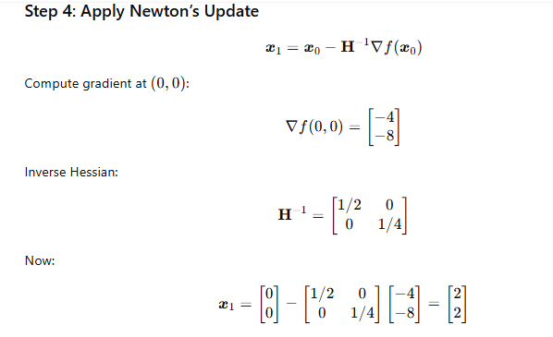
Newton's Method
Example:2

Slide 7

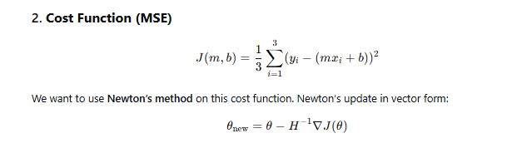

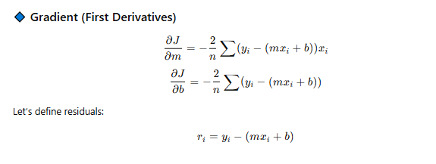
Newton's Method
Example:3

Slide 8
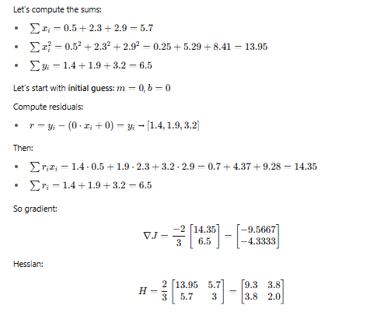
Newton's Method
Example:3

Slide 9
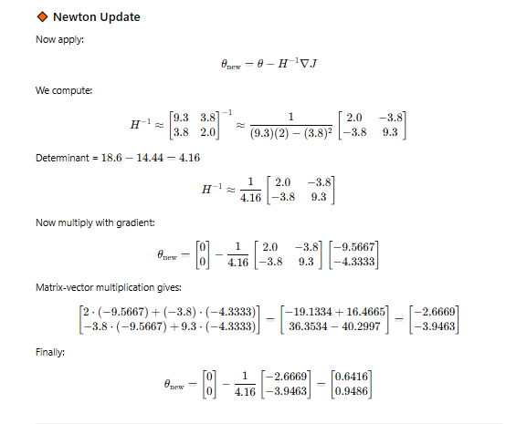
Newton's Method
Example:3

Slide 10
Newton's Method
SAMPLE QUESTIONS
Describe how Newton's method operates as an optimization algorithm and state the specific formula governing its parameter adjustments.
Explain how Newton's method uses curvature (second derivative) to improve convergence.
Let f: R —> R. be given by f ( X ) = (X-X0)⁴, where X0 ∈ R is a constant. Suppose that we apply Newton's method to the problem of minimizing f. Write down the update equation for Newton's method applied to the problem.
Apply Newton's method, find the minimizer of f(x)=1/2 x²-sin(x) the initial value is x⁽⁰⁾=0.5 the required accuracy is 10⁻⁵.

Slide 11
Thank You

